Slide 1

Week 5 Celebration
September 1, 2020

Slide 2
**Announcements for the last week**
All weight gain fees due by weigh-in next Tuesday either Venmo or cash at (club)
All weigh-ins before 11am Tuesday
Weigh within one hour of time on day 1
Same scale and if possibly same outfit as day 1
Registration for the next challenge is open through Saturday

Slide 3
Weekly weight loss

Slide 4
0.4lbs Sarah
Insert
Photo
Here

Slide 5
-1.0lbs Deanna & AManda
Insert
Photo
Here
Insert
Photo
Here

Slide 6
-1.2lbs Kristi
Insert
Photo
Here

Slide 7
-1.4lbs Cindy
Insert
Photo
Here

Slide 8
-1.6lbs Katrina
Insert
Photo
Here

Slide 9
-2.0lbs Shelly & Borg
Insert
Photo
Here
Insert
Photo
Here

Slide 10



Take care of your body – inside and out

Slide 11
Weekly Challenge Winners

Slide 12
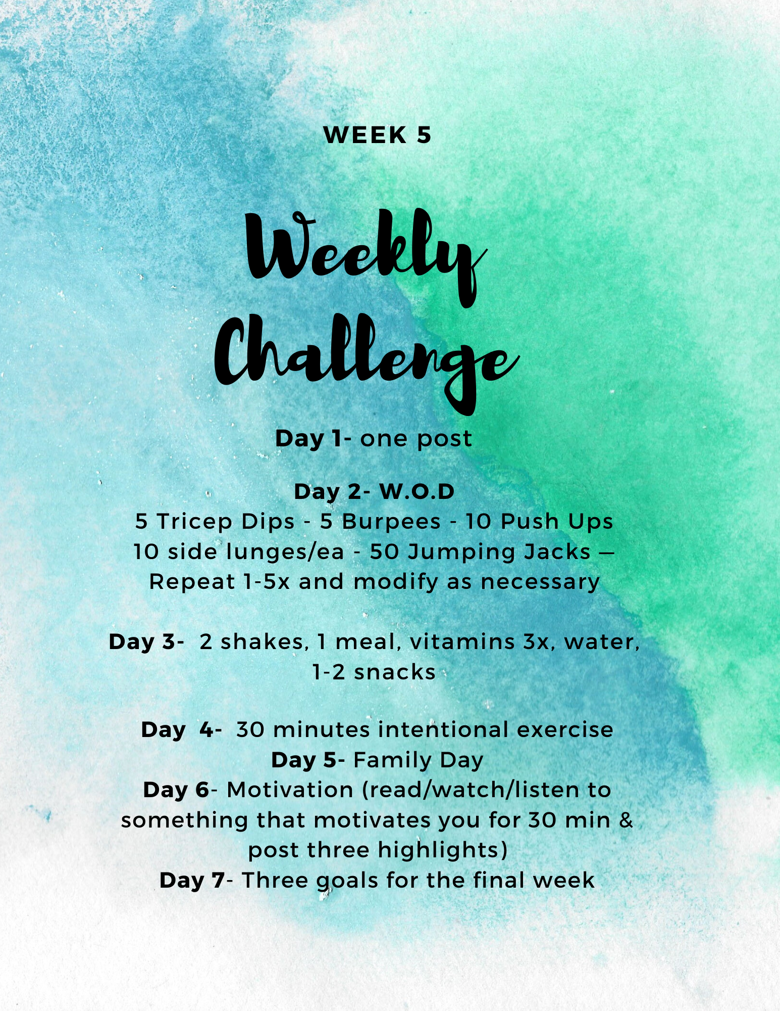
Week 5

