Slide 1

Week 4 Celebration
August 25, 2020

Slide 2
NEXT CHALLENGE

Slide 3
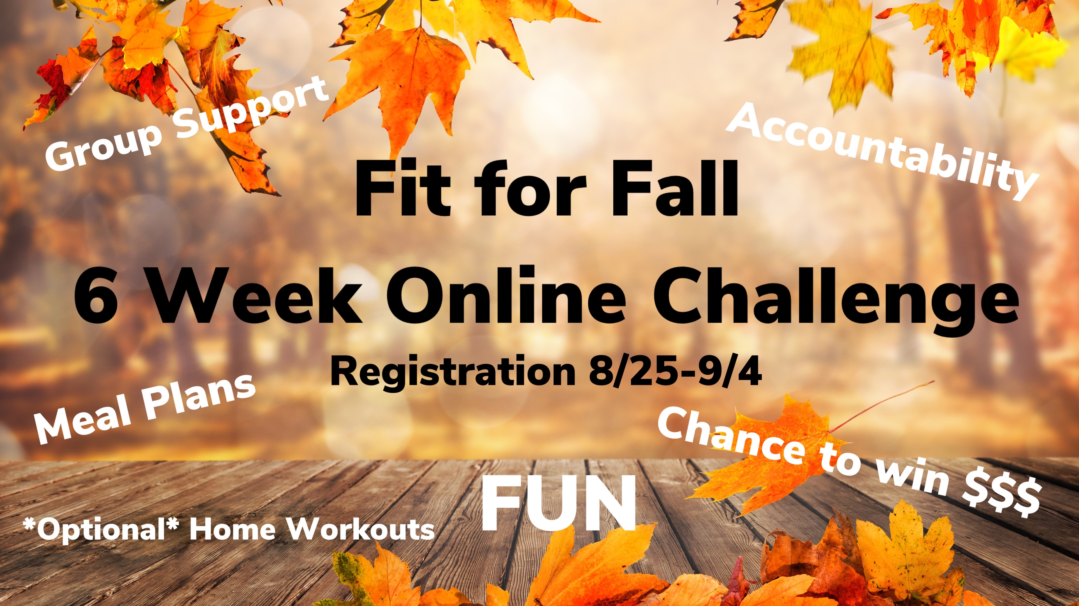

Slide 4
Weekly Weight Loss
**Set reminders for weigh-ins
**Two weeks left

Slide 5
0.4 lbs – Katrina
Insert
Photo
Here

Slide 6
0.5 lbs – Vanessa
Insert
Photo
Here

Slide 7
1.0 lbs – Bobbie Lea
Insert
Photo
Here

Slide 8
-1.2 lbs Deanna
Insert
Photo
Here

Slide 9
-1.6lbs Teresa
Insert
Photo
Here

Slide 10
-1.8lbs Shelly E.
Insert
Photo
Here

Slide 11
-2.4lbs Borg
Insert
Photo
Here

Slide 12
-2.6 lbs Tom & Sarah
Insert
Photo
Here
Insert
Photo
Here

Slide 13
-3.0 lbs Amanda
Insert
Photo
Here

Slide 14
-3.8lbs Madasynn
Insert
Photo
Here

Slide 15
Week 4 Winner -4.4 lbs Bobby
Insert
Photo
Here

Slide 16

Heart Health

Slide 17






Herbalife 24

Slide 18
Week 3 Challenge Winners

Slide 19
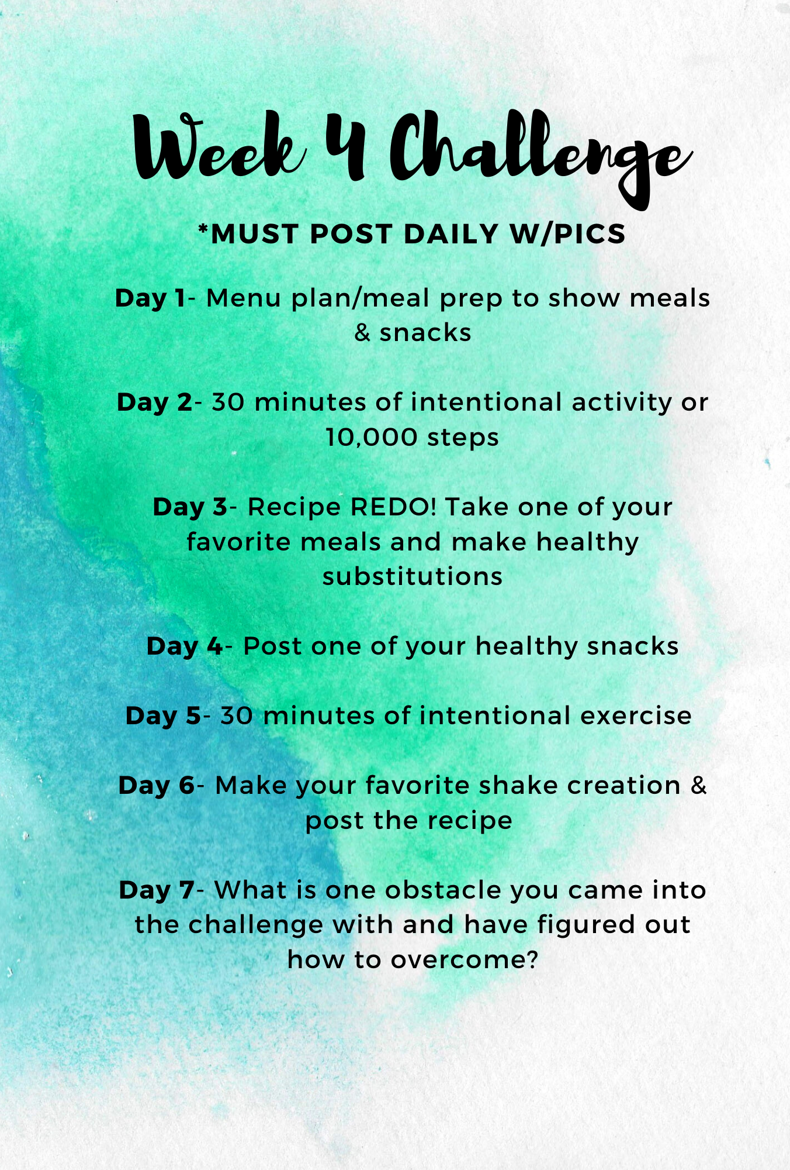
Week 4 Challenge

