Slide 1

Week 3 Celebration
August 18, 2020

Slide 2



Amanda & Deanna -.2
Insert
Photo
Here
Insert
Photo
Here

Slide 3
-.6 lbs Tena and Shelly E.
Insert
Photo
Here
Insert
Photo
Here

Slide 4
-1.0 lbs April
Insert
Photo
Here

Slide 5
-1.2 lbs Sam & Borg
Insert
Photo
Here
Insert
Photo
Here

Slide 6
-1.6 lbs Lyss & Bobbie lea
Insert
Photo
Here
Insert
Photo
Here

Slide 7
-1.8 lbs Teresa
Insert
Photo
Here

Slide 8
-2.2 lbs Madasynn
Insert
Photo
Here
Insert
Photo
Here

Slide 9
-2.4 lbs Vanessa & Shelly M.
Insert
Photo
Here
Insert
Photo
Here

Slide 10



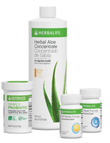
Digestive Health
Simply Probiotic
21 Day Balancing Program
Active Fiber Complex
Herbal Aloe Concentrate (Drink as much as you can afford)
Cranberry, Mandarin and Mango

Slide 11
TOP 10
10- Dani S. -2.081
9- Sam P. -2.085%
8- Madasynn -2.15%
7- Sarah -2.57%
6- Alyssa -2.62%
5- Katrina -2.68%
4- Kristi -2.70%
3- Teresa -2.90%
2- Amanda -4.17%
1- Shelly Meyers -4.68%

Slide 12
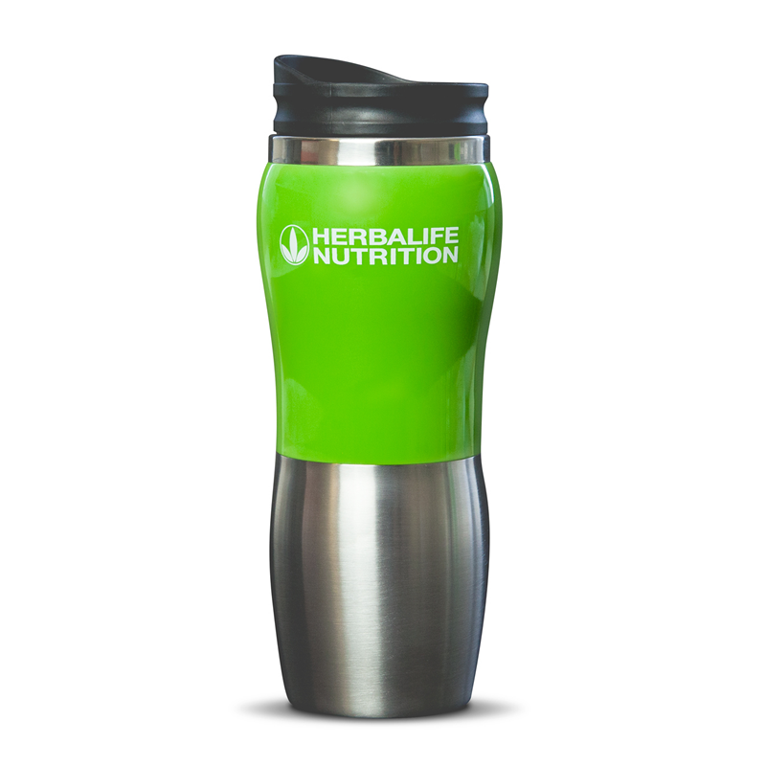
Weekly Challenge Winners
Deanna
Shelly M.

Slide 13
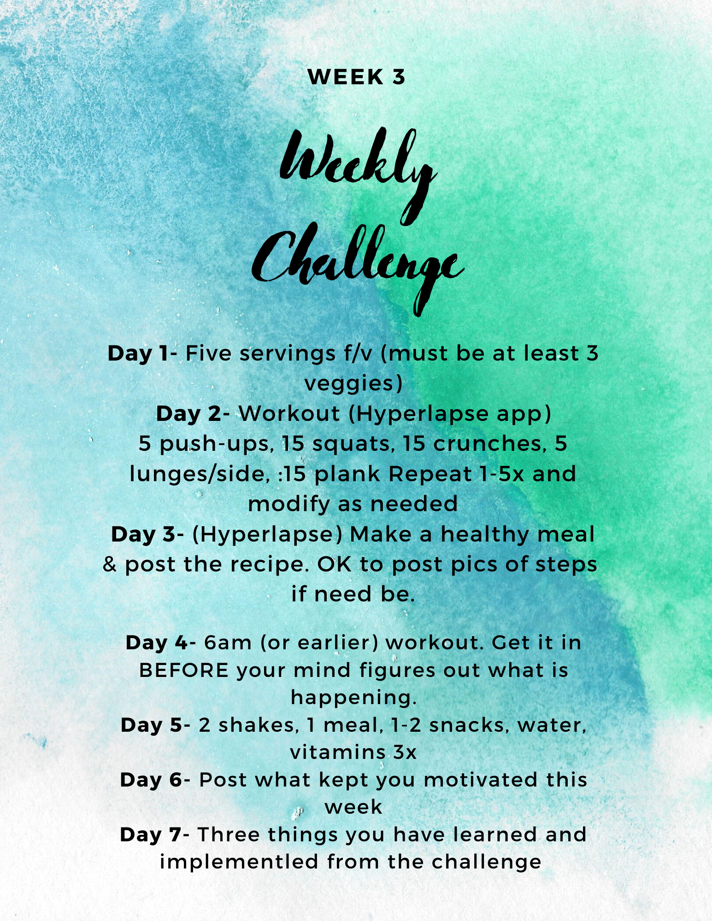
Next Weekly Challenge

