Slide 1

Week 2 - Celebration
June 23, 2020

Slide 2
-0.4lbs Angie
Insert
Photo
Here

Slide 3
-1.4lbs Jessica H., Andrew B., Taran
Insert
Photo
Here
Insert
Photo
Here
Insert
Photo
Here

Slide 4
-1.6lbs Jill
Insert
Photo
Here

Slide 5
-2.0lbs Jess T. and Cindy
Insert
Photo
Here
Insert
Photo
Here

Slide 6
-2.2lbs Jess C.
Insert
Photo
Here

Slide 7
-2.5lbs Tessa
Insert
Photo
Here

Slide 8
-2.8lbs Andrew K.
Insert
Photo
Here

Slide 9
-2.9lbs Becky
Insert
Photo
Here

Slide 10
-3.2 lbs – Peggy
Insert
Photo
Here

Slide 11
-3.8lbs Heather
Insert
Photo
Here

Slide 12
-5.0 lbs Kendra
Insert
Photo
Here

Slide 13
-5.4lbs Madasynn
Insert
Photo
Here

Slide 14
-6.2lbs Sabrina
Insert
Photo
Here

Slide 15
-6.8lbs Sarah
Insert
Photo
Here

Slide 16
RECAP Week 1
10:1 Calorie to protein ratio
If it has 100 calories, needs 10g (or more) protein
Grocery shopping
Meal Prepping
WATER?

Slide 17
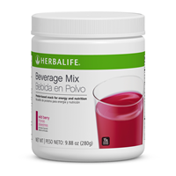
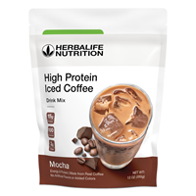
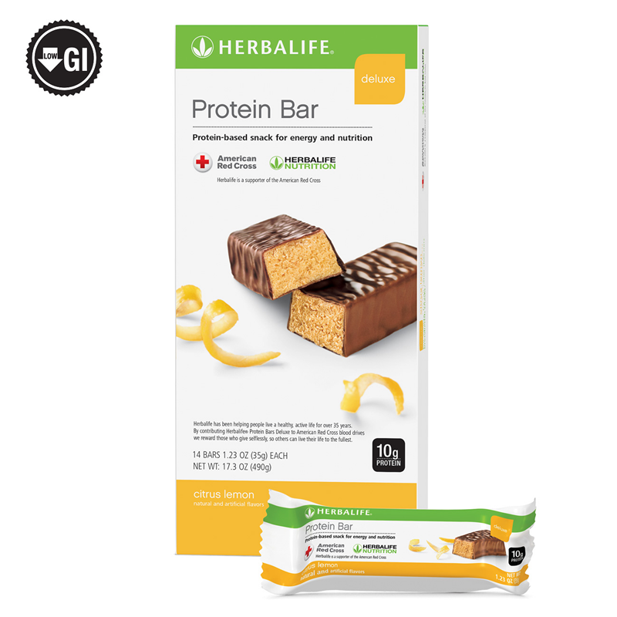
Protein Snacks

Slide 18
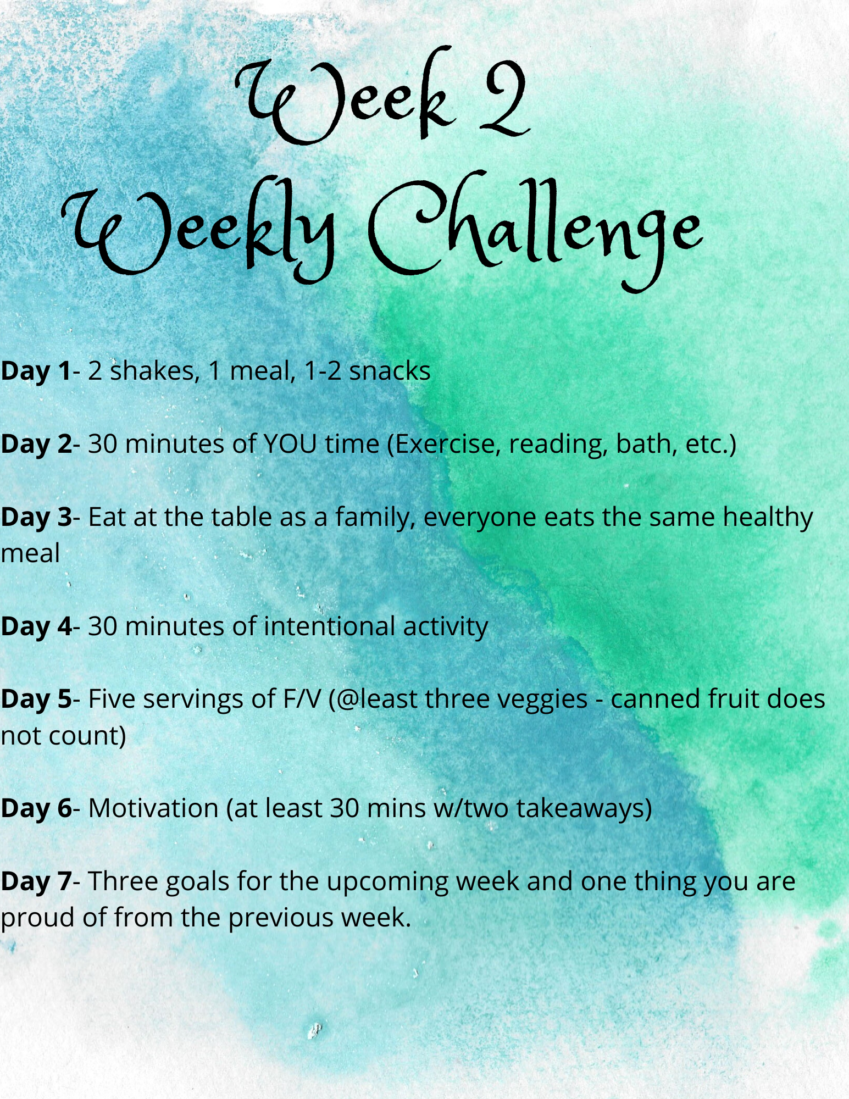
Weekly Challenge

