Slide 1

Heat of Summer 2020 ONLINE Transformation Challenge
Week 1 Celebration
August 4, 2020

Slide 2
Weekly Weight Loss
Insert
Photo
Here
Insert
Photo
Here
-0.6lbs Shelly, Tena and Alyssa
Insert
Photo
Here

Slide 3
Insert
Photo
Here
-0.8lbs Teresa

Slide 4
Insert
Photo
Here
-1.0 lbs Angie

Slide 5
-1.2 lbs
sarah
Insert
Photo
Here

Slide 6
-1.4 lbs Sam P.
Insert
Photo
Here

Slide 7
-1.6 lbs Katrina
Insert
Photo
Here

Slide 8
-3.2 lbs Madasynn & Kristi
Insert
Photo
Here
Insert
Photo
Here

Slide 9
-3.6 lbs Shelly
Insert
Photo
Here

Slide 10
-4.2 lbs Stacy
Insert
Photo
Here

Slide 11
-4.8lbs April
Insert
Photo
Here

Slide 12
-5.6lbs Amanda
Insert
Photo
Here

Slide 13
-8.6 lbs Tom Week 1 Winner
Insert
Photo
Here

Slide 14
Let’s Recap
Breakfast Shake *Within 45 minutes of waking up
½ body weight in ounces of water/day
10:1 Calorie to Protein Ratio
Start slow
80% Nutrition, 20% Exercise
One step at a time. Keep it simple.
Grocery Shopping

Slide 15
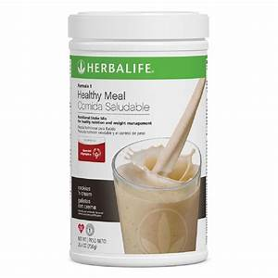
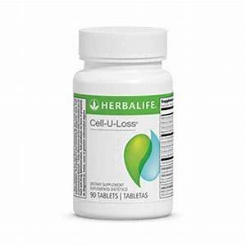
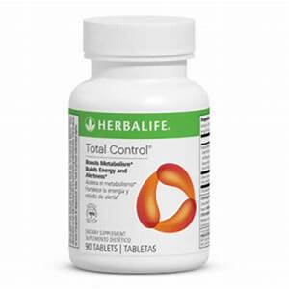
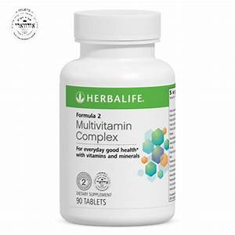
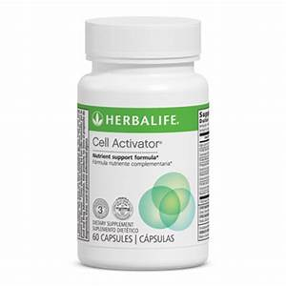


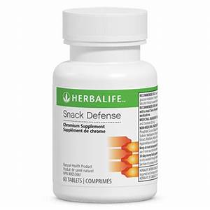
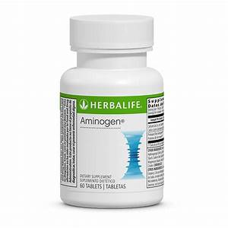
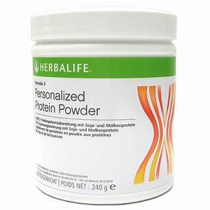
Weight Loss Programs

Slide 16
