Slide 1

Fit for Fall 2020 Transformation INTRO
Summer 2020 PAYOUT
Start Date: 9/8/2020
Final Weigh-In: 10/20/2020
Hosted by: _____________

Slide 2



Recognition

Slide 3
ANDREW -0.2 LBS
Insert
Photo
Here

Slide 4

-0.6 lbs Bobby & Tom
Insert
Photo
Here
Insert
Photo
Here

Slide 5
-.8 lbs Katrina
Insert
Photo
Here

Slide 6
-1.2lbs Deanna
Insert
Photo
Here

Slide 7
-1.6 lbs Amanda
Insert
Photo
Here

Slide 8
-2.2 lbs Alyssa
Insert
Photo
Here

Slide 9
-2.8lbs Tena
Insert
Photo
Here

Slide 10
-3.6 lbs Cindy
Insert
Photo
Here

Slide 11
-4.8lbs April
Insert
Photo
Here

Slide 12
WELCOME Fit for Fall 2020 Challengers

Slide 13
What does the VIRTUAL transformation look like?
Weekly weigh in (Tuesday by 11am)
Post in private FaceBook group a minimum of once a day, 5/7 days (We will discuss what to post)
Activity accountability
Two shakes/day, 1 colorful meal, 1-3 snacks (See meal guide)

Slide 14
Participant Checklist:
Participation Agreement
Entry Fee Paid
Completed Health Survey
Formula 1 Healthy Meal and Protein Drink Mix (SKU1426)

Slide 15
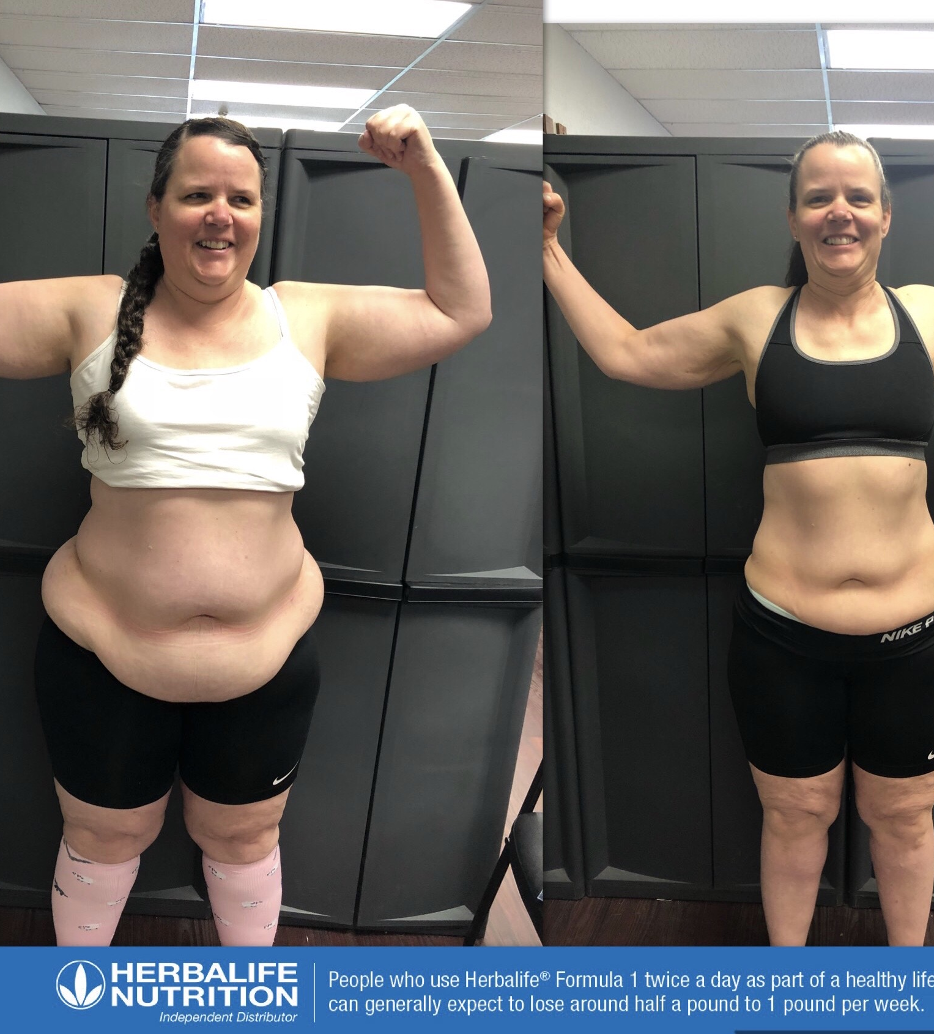
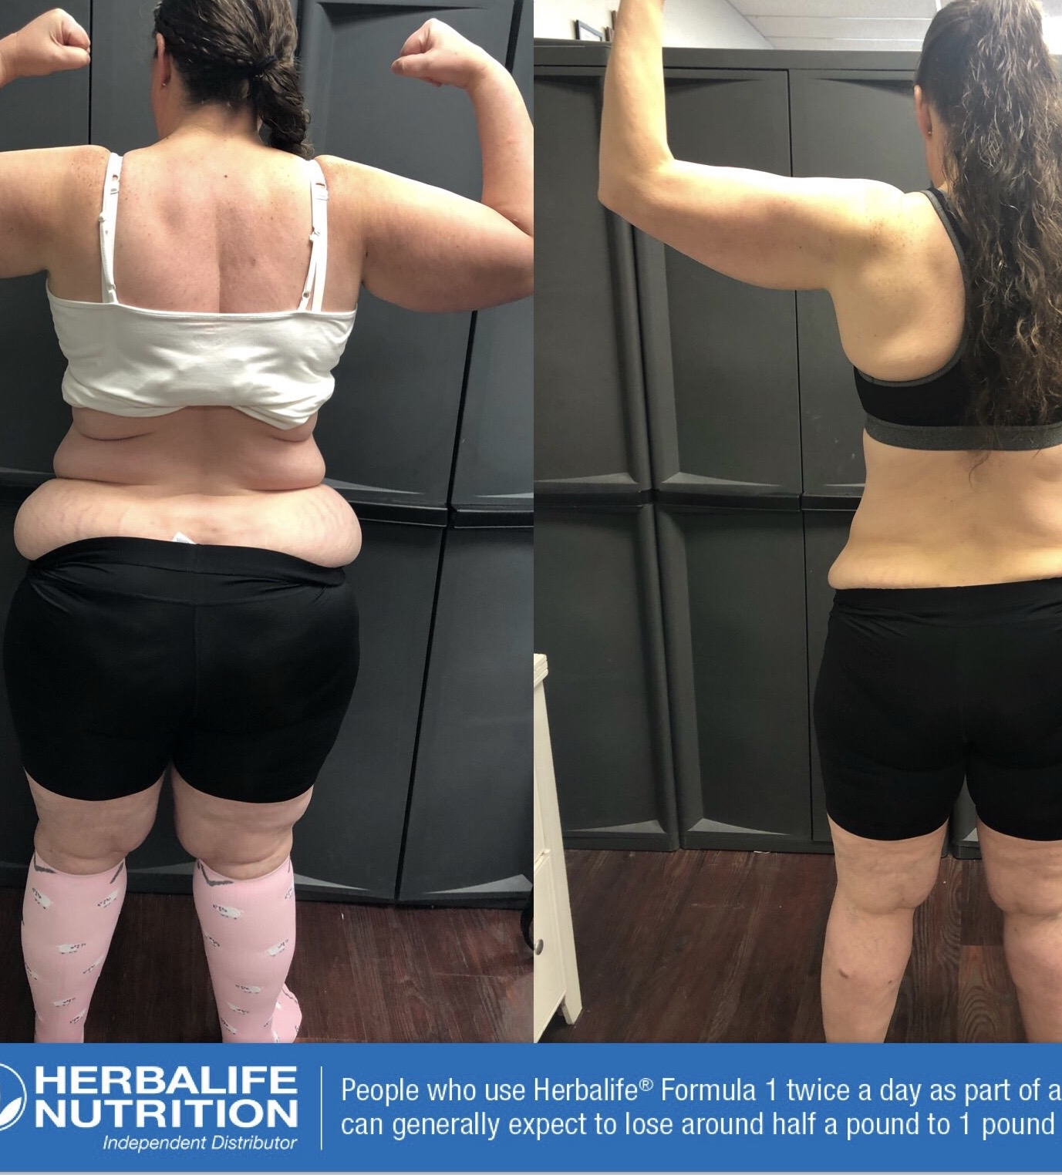
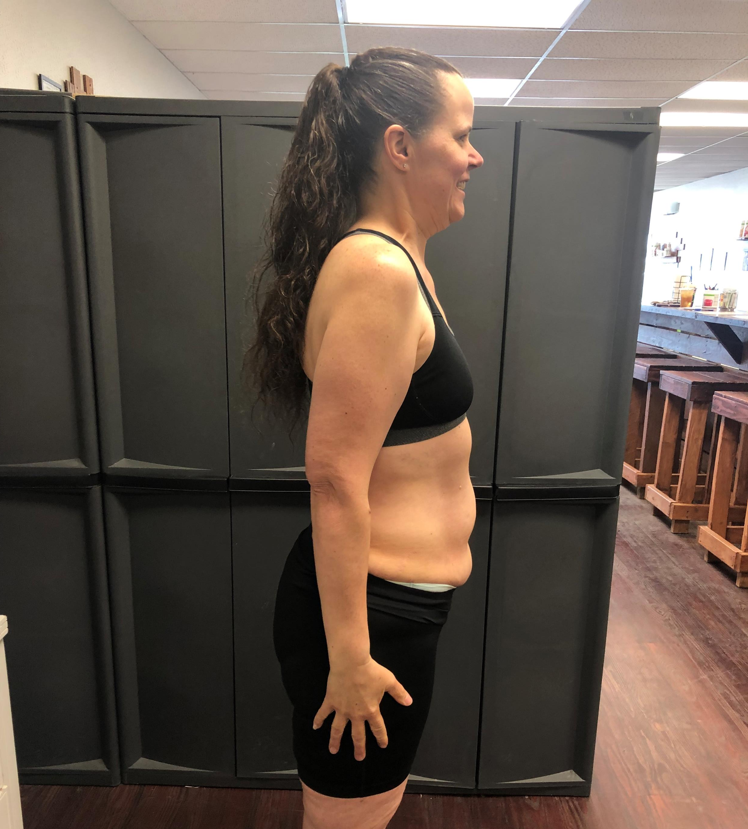
Pictures

Slide 16
Measurements
Upper Chest (Under armpits)
Across chest (Nipple level)
Waist (Belly button)
Hips (Center of butt)
Thighs (stand up straight, hands to the side)
Arms (biceps, 3” up from elbow)
Neck (hold hair up)

Slide 17
Introduction Week
Calories, Protein, WATER
Breakfast

Slide 18
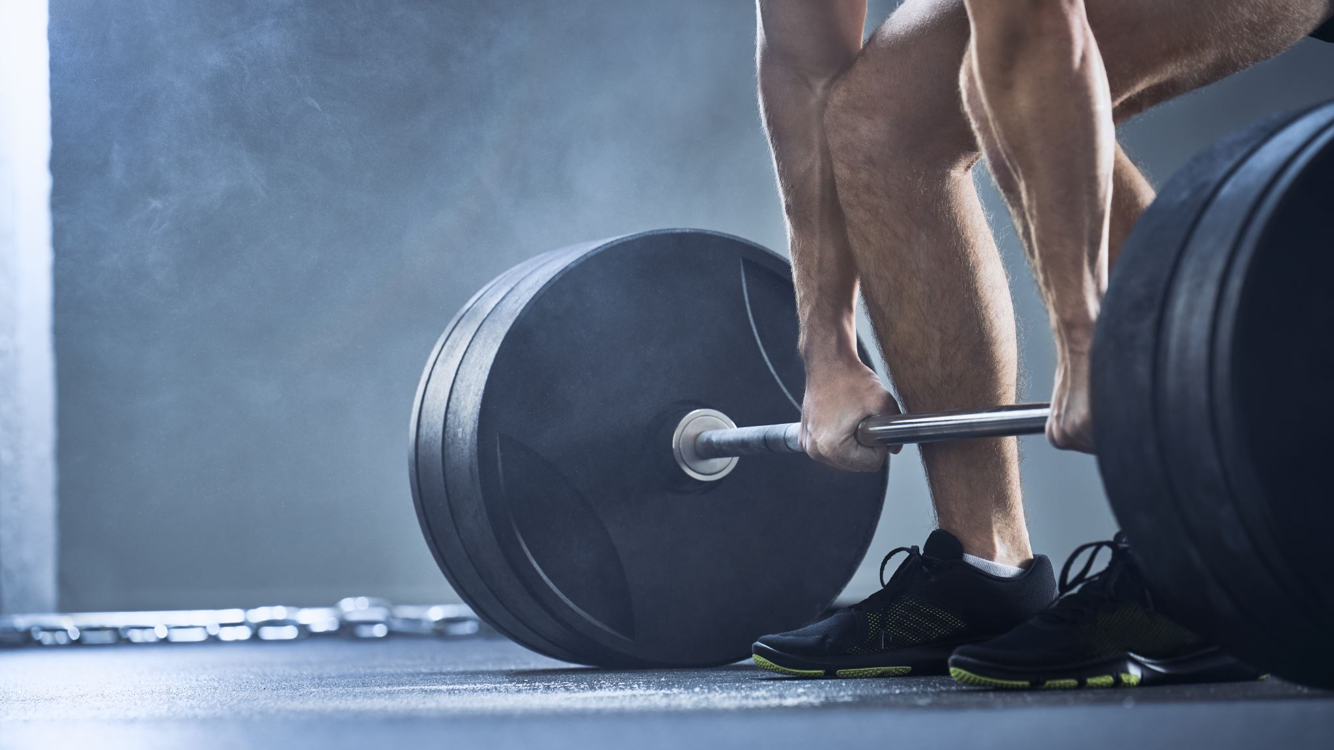
Rate your fitness level on a scale of 1-10

Slide 19
What’s next?
Any friends who didn’t join can weigh in until Thursday 11am and do the required steps
Weekly check-in for 15-20 minutes via ZOOM. Time _________
TODAY or TOMORROW– 1 post required. Introduce yourself.
Post pic of YOU, what you do, family, WHY you joined this challenge

Slide 20
Summer 2020 PAYOUT

Slide 21
TOP 10
10. Alyssa -2.03%
9. Kristi -2.70%
8. Cindy -2.93%
7. Borg -3.08%
6. Tom -3.49%
5. Katrina -4.24%

Slide 22
4th Place Deanna -4.28% Penalty Pot $32
Insert
Photo
Here

Slide 23
3rd Place Teresa -4.46% $101
Insert
Photo
Here

Slide 24
2nd Place Shelly M -4.95% $152
Insert
Photo
Here

Slide 25
1st Place Amanda -7.41% $253
Insert
Photo
Here

