Slide 1
Wellness Seminar Carolina Nutrition
YOUR NAME
Wellness Coach
Helping you reach your goals!

Slide 2
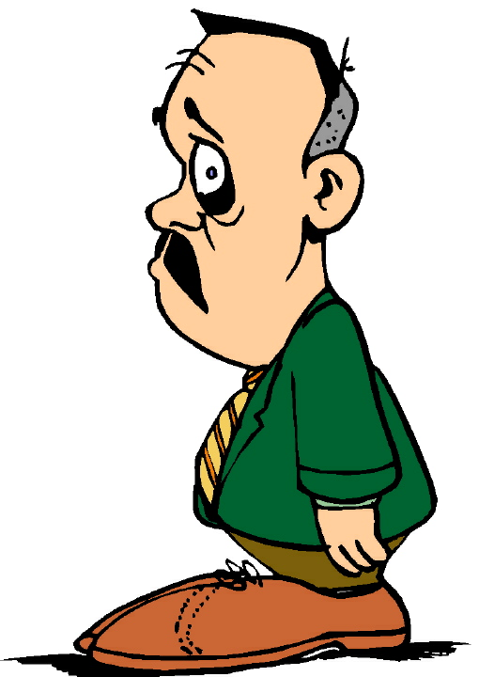
2
Principal causes of
Premature Deaths
American
Medical
Association.
A.M.A.
Cancer
Heart Attacks
Diabetes
Strokes
“That 50% of these deaths could have been prevented with a
healthier eating habits ”

Slide 3
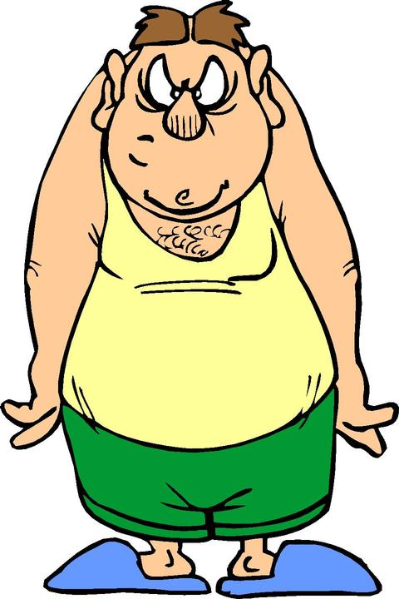
3
“ 70% of all the visits to the doctor are due to conditions relating with
bad eating HABITS”
American
Medical
Association.
A.M.A.
Main Health Complains
Fatigue or Tiredness
Stressed
Digestive Problems
Gall Bladder
Hemorrhoids
Cholesterol
Triglycerides
High Uric Acids
Circulations Problems
Spider Veins
High/Low Blood Pressure
Menstrual Problems
Constipation
Headaches
Dizziness
Migraines
Insomnia
Depression
Osteoporosis
Diabetes Type II
Kidney Problems
Immune Deficiency
Overweight Problems
Obesity Problems
General Illnesses
Etc….

Slide 4
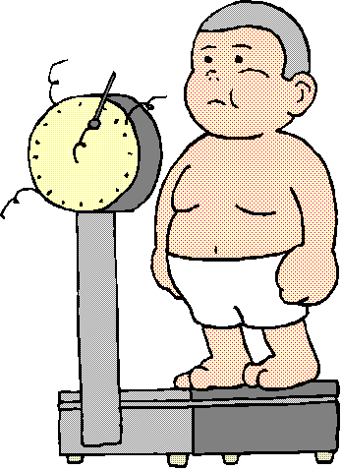
4
U.S.A.
American
Medical
Association.
A.M.A.
 | Year 1980 | Year 2010
Overweight | 33% | 68%
OBESITY | 14% | 33%
The Obesity in our Children
Is considered an
Epidemic.
www.nbc.com

Slide 5
Excesses & Deficiencies
**According to the Centers for Disease Control and Prevention**
1 - Eating Out
2 - Super-sizing
The “small” size can even exceed a single recommended serving!
3 - Liquid Sugar
Soda & sugary drinks
4 - Too much TV

Slide 6
Excesses & Deficiencies
Our diets are HIGH in:
Fat
Sugar
White flour
Salt
Preservatives
Food coloring
Our diets are LOW in:
Vitamins
Minerals
Fiber
Protein
Amino Acids
Phytonutrients
Antioxidants

Slide 7
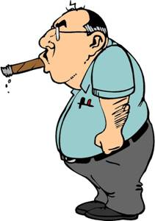



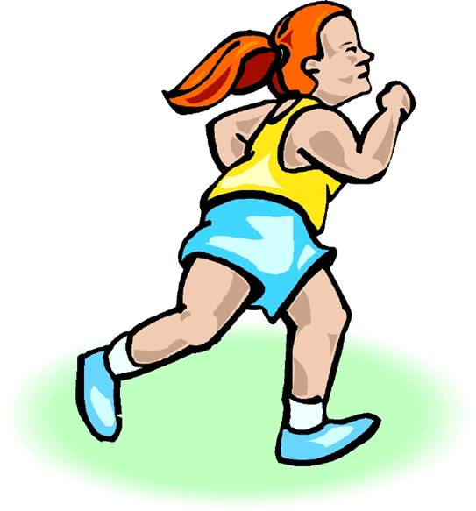
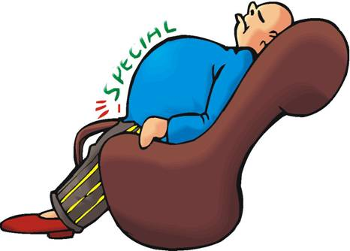

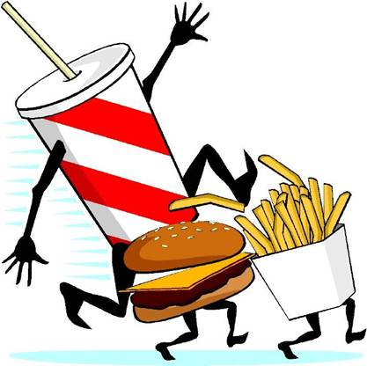
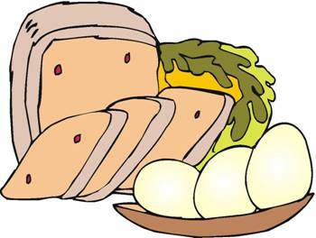
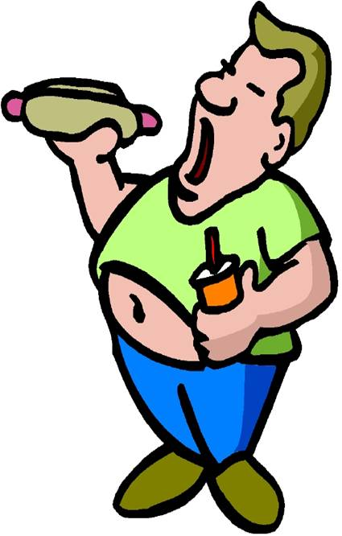


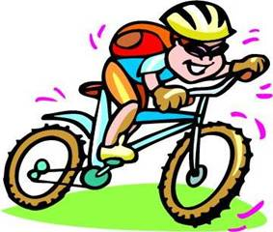
7
This is a Typical Diet to get Sick, Overweight and Die at an early age.
EXCESSES
DEFICENCIES

Slide 8
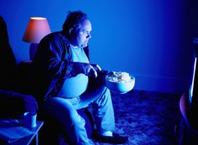
Active Sedentary Lifestyle
Manually change channel → Remote control
Raise garage door → Garage door opener
Cook for 30 min → Pizza delivered
Wash car → Go to car wash
Mow the grass → Hire someone to Mow
Walk dog → Let dog out
Shop at mall → Shop online
Climb stairs → Escalator

Slide 9

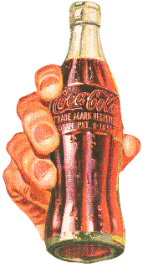
Increased Corn Syrup Calories
1950
2011
509 kcal
100 kcal
Don’t forget the Free Refills!
Classic Cola
8 fluid oz
42 fluid oz

Slide 10
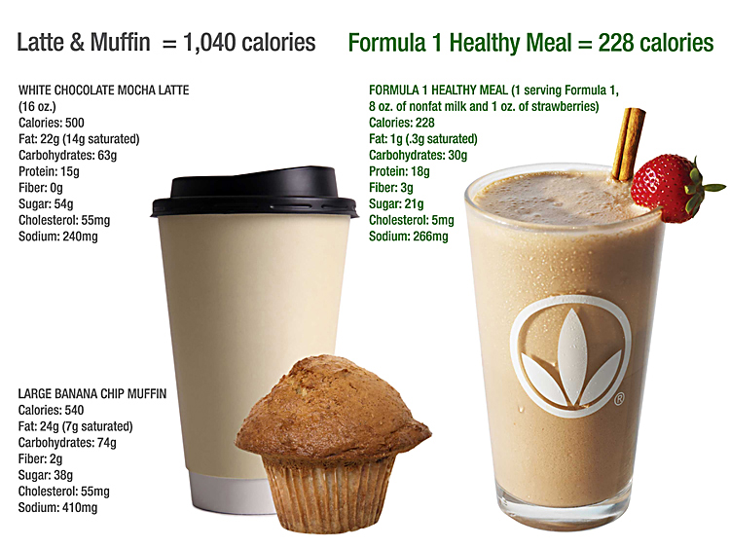

Slide 11

Living on Coffee?? Soda??

Slide 12
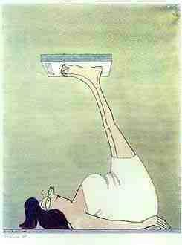
Is this how you weigh yourself?

Slide 13
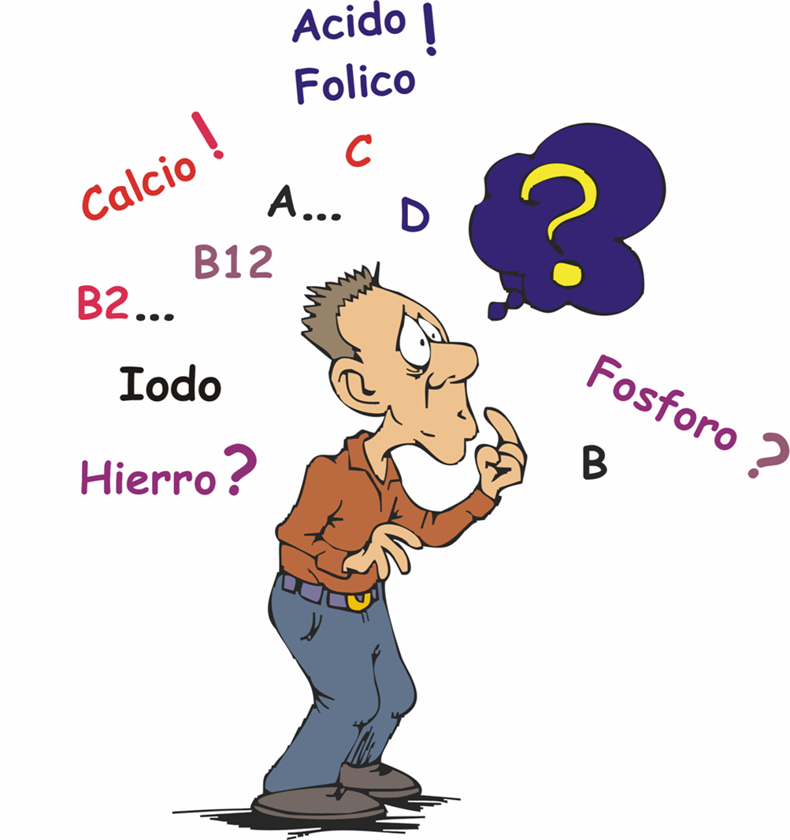
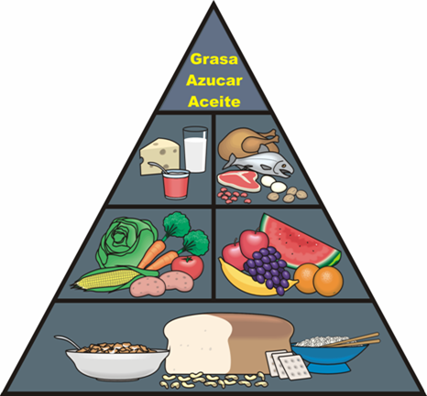
WHY ARE WE EATING INCORRECTLY?
13
1. Lack of Information
Nutrients | Necessity | Normal Consumption
Calories | 1,500-1,750 | 3,000-5,000
Proteins | 100-150 gr. | 35-45 gr.
Carbohydrates | 270-315 gr. | 450-750 gr.
Fats | 60-70 gr. | 120-200 gr.
Cholesterol | 200 mg | 500-1,000 mg
Fiber | 25-35 gr. | 8-15 gr.
A | 5,000 u.i | 100-500 u.i.
C | 60 mg | 0-20 mg
B1 | 1.5 mg. | 0.5 mg.
B2 | 1.7 mg. | 0.5 mg.
Niacin | 20 mg. | 5 mg.
B6 | 2 mg. | 0.5 mg.
Folic Acid | 400 mg. | 0 mg.
B12 | 6 mg. | 1-3 mg.
Calcium | 1,200 mg | 300-600 mg.
Phosphate | 1,200 mg. | 400 mg.
Iron | 16 mg. | 8 mg.
Magnesium | 400 mg. | 100 mg.
Salt | 500 mg. | 20,000 mg.
Potassium | 3,500 mg. | 3,000 mg.
Zinc | 15 mg. | 7 mg.
Folic
Acid !
Calcium ?
Iodine ?
Magnesium
Iron ?

Slide 14

WHY ARE WE EATING INCORRECTLY ?
14
2. Bad Habits

Slide 15
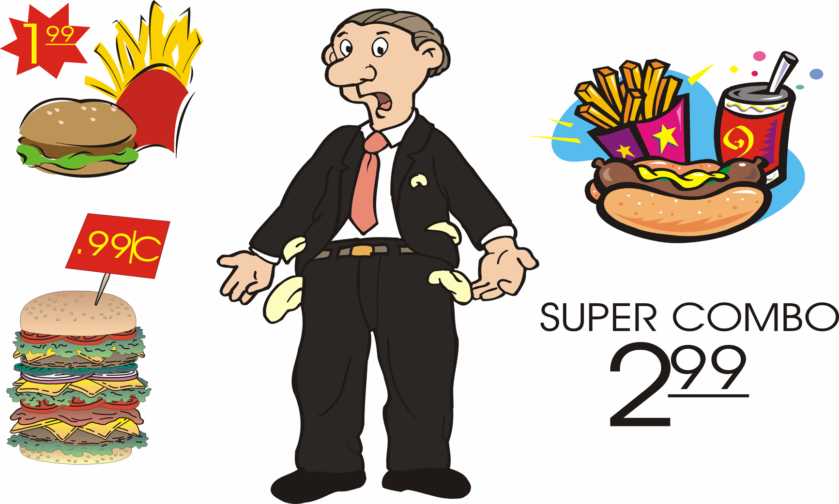
WHY ARE WE EATING INCORRECTLY ?
15
3. MONEY

Slide 16

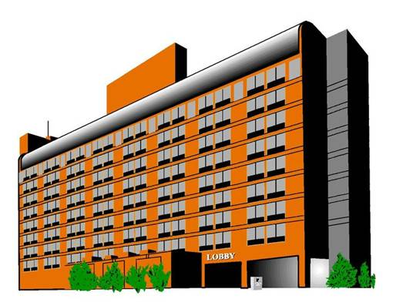

WHY ARE WE EATING INCORRECTLY?
16
4. Time.

Slide 17
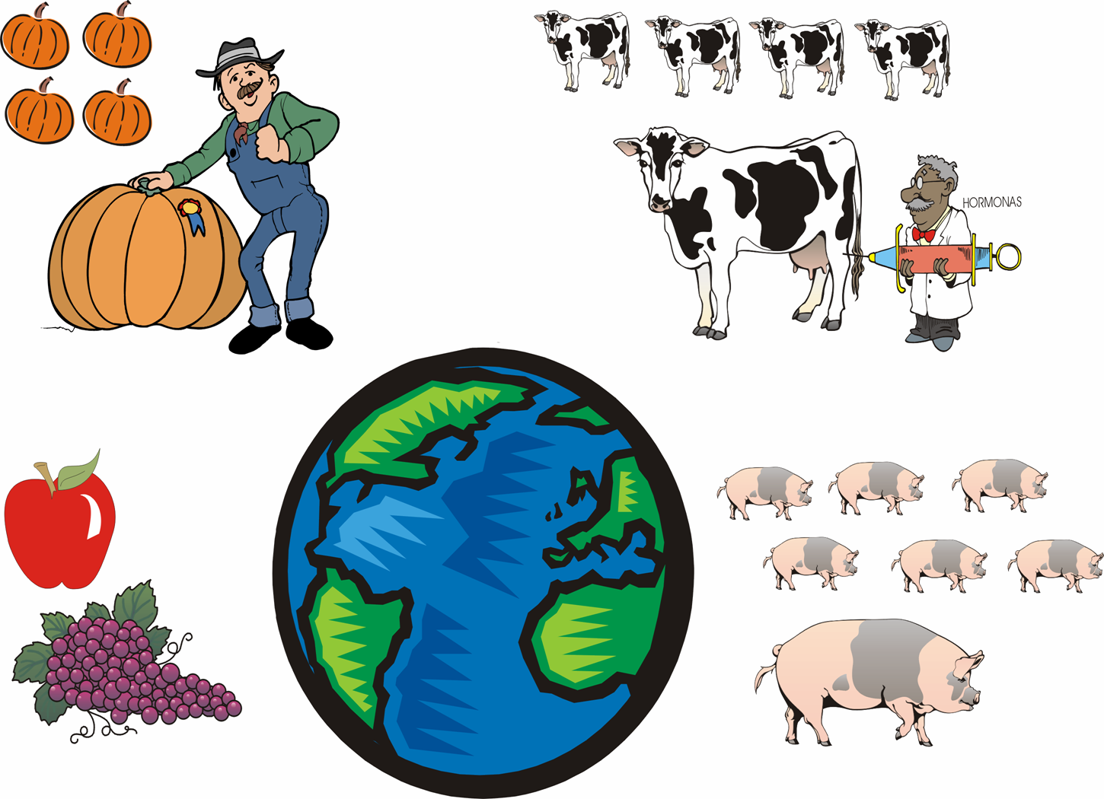
WHY ARE WE EATING INCORRECTLY?
17
5.-Over Population.
Hormones
Antibiotics
Preservatives
Coloring
Wax
Chemical
Gasses
Refrigerated
Others….
NUTRITIONAL DEFICENCY

Slide 18
Understanding metabolism, a key in good nutrition
The rate your body burns fat throughout the day
Every pound of lean body mass burns 14 calories per day
Every pound of body fat burns 2 calories per day
So to increase your metabolism
increase lean body mass
decrease body fat

Slide 19
So…how do I raise my metabolism?
Exercise & strengthen your muscles
More protein in your diet
More exercise & protein will help you gain lean muscle and lose excess body fat

Slide 20
Protein Basics
Composed of 22 amino acids (building blocks)
Protein Benefits your diet
Protein helps control hunger
Raises your metabolism
Helps to maintain blood sugar levels
A lack of Protein
Loss of muscle
Decrease immunity
Weakening of circulatory & respiratory systems

Slide 21
Snack Basics
Listen to your body’s signals and stay hydrated
Our bodies are designed to need nutrients every 3 to 4 hours
Snacks should include both healthy carbohydrate, such as a fruit or vegetable, AND a protein food or beverage

Slide 22
Importance of Water
60-70% of your body is water
Obesity decreases the percentage of body water – to as low as 45%
8-12 cups of water are lost daily and must be replaced
Thirst is often misinterpreted as hunger
Drink eight 8-oz glasses per day
Overweight people need one additional glass per 25 pounds of excess weight
Drink more if you exercise briskly or it’s hot

Slide 23
Become a “Mover”
Walk up the escalator or bypass the elevator and takes the stairs
Park far from the main entrance and walk
Turn off the TV and walk the dog
Put on lively music while you do housework
A brisk walk can burn up to 100 calories per mile or 300 calories per hour

Slide 24
Know your Numbers:
Blood Pressure
Cholesterol (Good & Bad)
Daily Calorie Needs
Ignorance is NOT Bliss!

Slide 25
Let’s Wrap it up PPPPPPPlease!
Personal Responsibility
Plan ahead
Prepare
Protein awareness
Portion control
Plenty of water
Promote a Healthy Active Lifestyle for you and your family

Slide 26
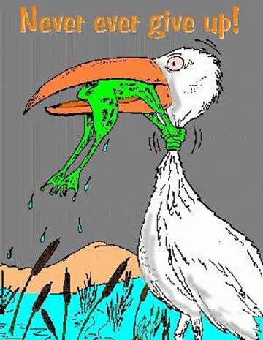

Slide 27
Carolina Nutrition
We provide a healthy alternative for breakfast, lunch, or a snack.
We provide weight management and wellness coaching
We sell nutrition supplements
Join us for FREE Fit Camp
Free Run/Walk Club
Schedule a FREE Wellness Evaluation TODAY!

Slide 28

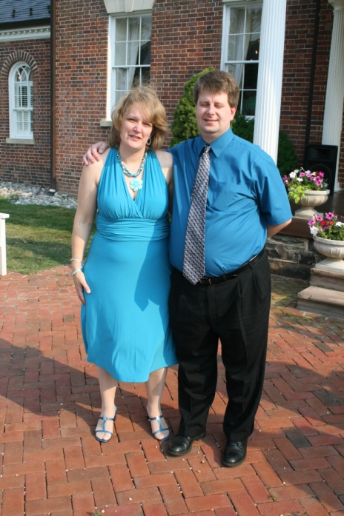
INSERT YOUR STORY (optional) example below:
In the summer of 2009, I found myself the heaviest I had ever been, weighing over 220 pounds, tired, and lacking energy to keep up with daily activities as a wife, mother of six, and teacher.
In January, 2010,
I made a New Year’s
Resolution that
changed my life, and
my family’s too.

Slide 29
Carolina Nutrition
4040 Ed Drive Suite 109
Raleigh, NC
www.CarolinaNutrition.NET
Mon – Fri 7am – 3pm
After Hours by Appt.
YOUR NAME
Wellness Coach
Phone
Email address

